Slide 1
Queue ADT!

Slide 2
Instructor
Dr. Ab Rouf Khan
Assistant Professor
VIT Bhopal University

Slide 3
Entry level Questions
How does a printer print the multiple jobs from different users synchronously?
How do we achieve multiprogramming in computer systems?

Slide 4
Outline (Queue)
Queue
Basic principles
Operations of Queue
Queue using Array (Static Implementation)
Queue using Linked List (Dynamic Implementation)
Applications of Queue
Breadth First Search

Slide 5
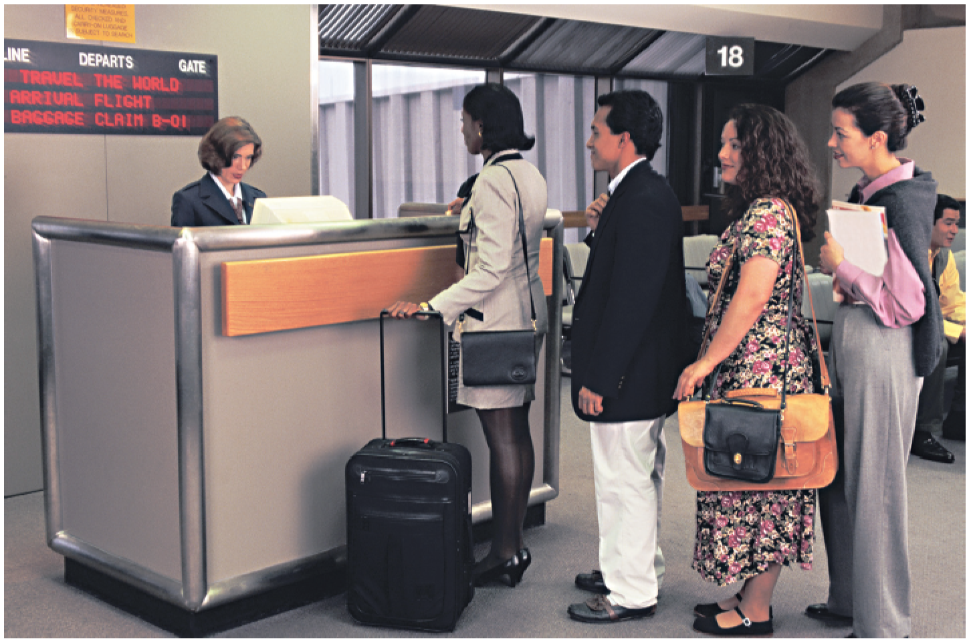
Queue – First IN, First OUT!

Slide 6
The Queue Data structure
The Queue ADT stores arbitrary objects.
Insertions and deletions follow the first-in first-out (FIFO) scheme.
Insertions are at the rear of the queue and removals are at the front of the queue.
Elements are stored in order of insertion but don't have indexes.
Client can only add to the end of the queue, and can only examine/remove the front of the queue
front |  | rear
1 | 2 | 3
dequeue, first
enqueue
Queue
Notes:
analogy: trays of food at the sizzler

Slide 7
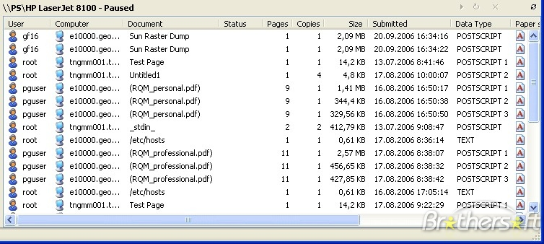
Queues in Computer Science
Operating systems:
queue of print jobs to send to the printer
queue of programs / processes to be run
queue of network data packets to send
Programming:
modeling a line of customers or clients
storing a queue of computations to be performed in order
Real world examples:
people on an escalator or waiting in a line
cars at a gas station (or on an assembly line)

Slide 8

Basic Idea
Unlike stacks, a queue is open at both its ends.
One end is always used to insert data (enqueue) and the other is used to remove data (dequeue).

Slide 9
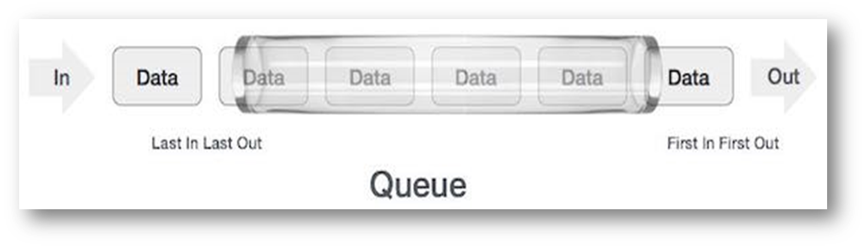
Queue Representation
Can be implemented by means of Array, Structure, Pointers and Linked List.

Slide 10
What are Queues good for?
Buffers
Breadth first search
Simulations
Producer-Consumer Problems
Round-robin scheduling in processors
Input/output processing
Queueing of packets for delivery in networks

Slide 11
Basic Queue Operations
enque()
QUEUE
deque()
create()
isempty()
size()

Slide 12
Basic Queue Operations
void enqueue (queue *q, int element);
/* Insert an element in the queue */
int dequeue (queue *q);
/* Remove an element from the queue */
queue *create();
/* Create a new queue */
int isempty (queue *q);
/* Check if queue is empty */
int size (queue *q);
/* Return the no. of elements in queue */
Assumption: stack contains integer elements!

Slide 13
Queue Model – FIFO
Empty Q
animal parade queue

Slide 14
Queue Model – FIFO
Q.enque(“ant”)
animal parade queue
ant
front
back/rear

Slide 15
Queue Model – FIFO
Q.enque(“bee”)
animal parade queue
ant | bee
front
back/rear

Slide 16
Queue Model – FIFO
Q.enque(“dog”)
animal parade queue
ant | bee | dog
front
back/rear

Slide 17
Queue Model – FIFO
Q.enque(“cat”)
animal parade queue
ant | bee | dog | cat
front
back/rear

Slide 18
Queue Model – FIFO
Q.deque()
animal parade queue
ant | bee | dog
front
back/rear

Slide 19
Queue Model – FIFO
Q.deque()
animal parade queue
ant | bee
front
back/rear

Slide 20
Queue Model – FIFO
Q.enque(“eel”)
Q.deque()
Q.deque()
animal parade queue
eel
front
back/rear

Slide 21
Array Implementation of Queues
A queue is a first in, first out (FIFO) data structure
This is accomplished by inserting at one end (the rear) and deleting from the other (the front)
0 1 2 3 4 5 6 7
myQueue:
17
23
97
44
front = 0
rear = 3
To insert: put new element in location 4, and set rear to 4
To delete: take element from location 0, and set front to 1

Slide 22
Array Implementation of Queues
front = 0
rear = 3
Initial queue:
17
23
97
44
After insertion:
17
23
97
44
333
After deletion:
23
97
44
333
front = 1
rear = 4
Notice how the array contents “crawl” to the right as elements are inserted and deleted
This will be a problem after a while!

Slide 23
Problem With Array Implementation
The size of the queue depends on the number and order of enqueue and dequeue.
It may be situation where memory is available but enqueue is not possible.
ENQUEUE
DEQUEUE
Effective queuing storage area of array gets reduced.
0
N
front
front
rear
rear
Use of circular array indexing

Slide 24
Linked List Implementation of Queues
In a queue, insertions occur at one end, deletions at the other end
Operations at the front of a singly-linked list (SLL) are O(1), but at the other end they are O(n)
Because you have to find the last element each time
BUT: there is a simple way to use a singly-linked list to implement both insertions and deletions in O(1) time
You always need a pointer to the first thing in the list
You can keep an additional pointer to the last thing in the list

Slide 25
SLL Implementation of Queues
In an SLL you can easily find the successor of a node, but not its predecessor
Remember, pointers (references) are one-way
If you know where the last node in a list is, it’s hard to remove that node, but it’s easy to add a node after it
Hence,
Use the first element in an SLL as the front of the queue
Use the last element in an SLL as the rear of the queue
Keep pointers to both the front and the rear of the SLL

Slide 26
Enqueueing a Node
Node to be enqueued
last first
44
97
23
17
To enqueue (add) a node:
Find the current last node
Change it to point to the new last node
Change the last pointer in the list header

Slide 27
Dequeueing a Node
last first
44
97
23
17
To dequeue (remove) a node:
Copy the pointer from the first node into the header

Slide 28
Linked List Implementation of Queues
Basic idea:
Create a linked list to which items would be added to one end and deleted from the other end.
Two pointers will be maintained:
One pointing to the beginning of the list (point from where elements will be deleted).
Another pointing to the end of the list (point where new elements will be inserted).
Rear
Front
DELETION
INSERTION

Slide 29
Enqueue Operation
ENQUEUE
front
rear

Slide 30
Dequeue Operation
DEQUEUE
front
rear

Slide 31
Queue Creation (Linked List Implementation)
struct qnode
{
int val;
struct qnode *next;
};
struct queue
{
struct qnode *qfront, *qrear;
};
typedef struct queue QUEUE;

Slide 32
Queue – Enqueue and Dequeue Operations
void enqueue (QUEUE *q,int element)
{
struct qnode *q1;
q1=(struct qnode *)malloc(sizeof(struct qnode));
q1->val= element;
q1->next=q->qrear;
q->qrear=q1;
}
Enqueue
int dequeue (queue *q)
{
int val;
queue *q1,*prev;
q1=q;
while(q1->next!=NULL)
{
prev=q1;
q1=q1->next;
}
val=q1->val;
prev->next=NULL;
free(q1);
return (val);
}
Dequeue

Slide 33
Queue Size and Queue Peek Operations
int size (queue *q)
{
queue *q1;
int count=0;
q1=q;
while(q1!=NULL)
{
q1=q1->next;
count++;
}
return count;
}
int peek (queue *q)
{
queue *q1;
q1=q;
while(q1->next!=NULL)
q1=q1->next;
return (q1->val);
}
Queue.Size()
Queue.peek()

Slide 34
Summary
A queue is called a FIFO (First in-First out) data structure.
What are some applications of queues?
Round-robin scheduling in processors
Input/output processing
Queueing of packets for delivery in networks
We can implementing a queue in two ways:
Using an array
Using a linked list

Slide 35

Recap

Slide 36
Thank You

